Slide 1
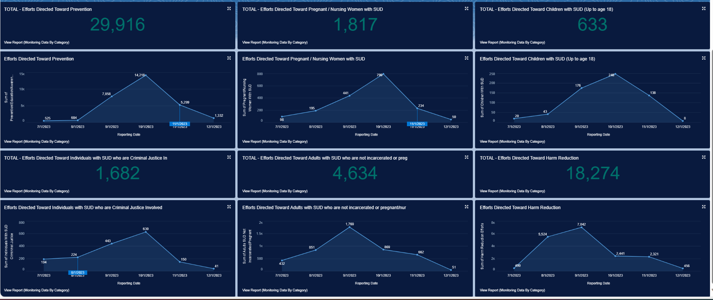
POSDC Monitoring Data
12/31/2023 @ 4:17PM

Slide 3
